Slide 1
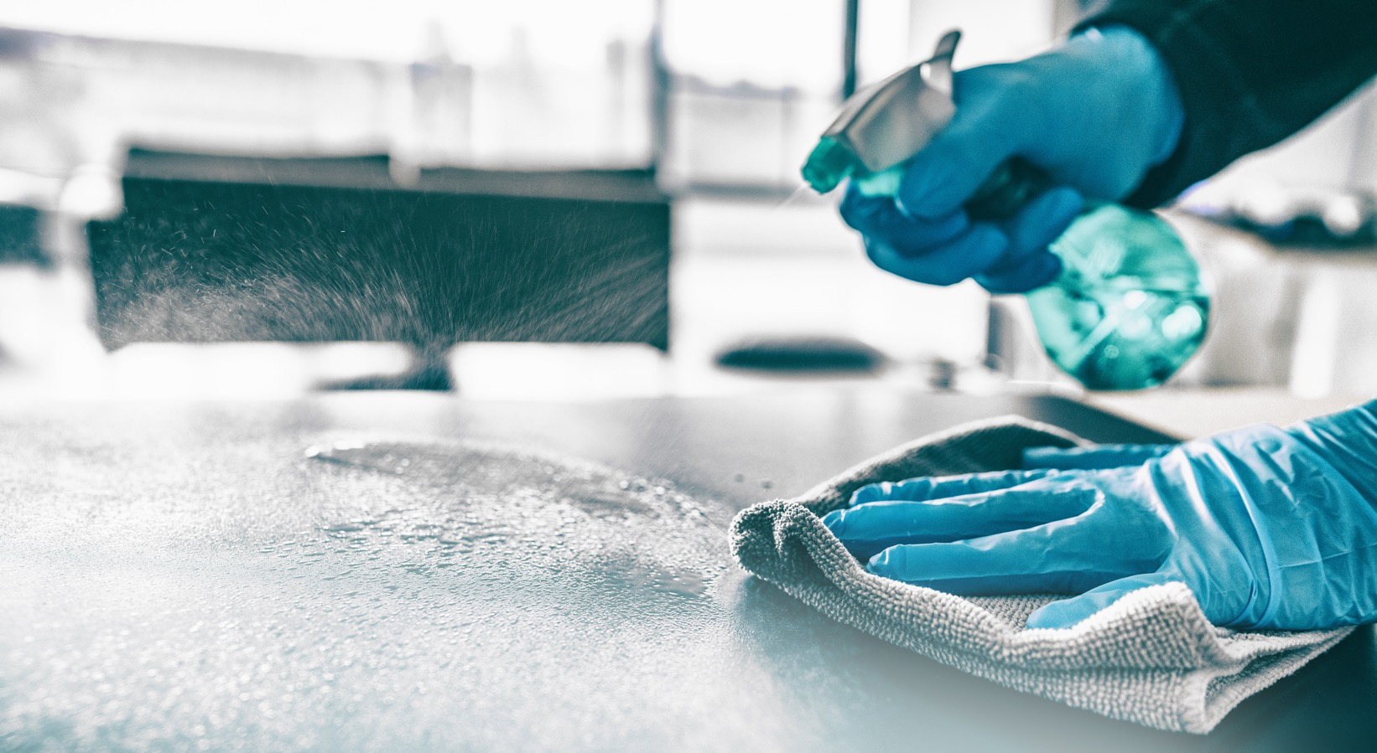
Support Services / Housekeeping

Slide 2
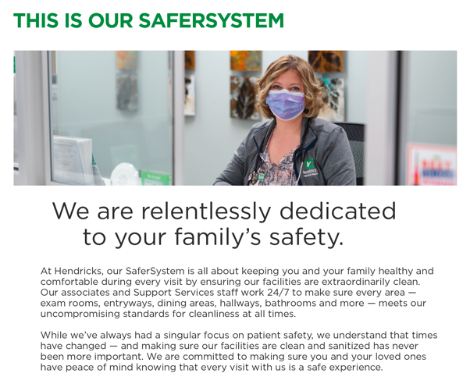
SAFERSYSTEM
CLEANING

Slide 3
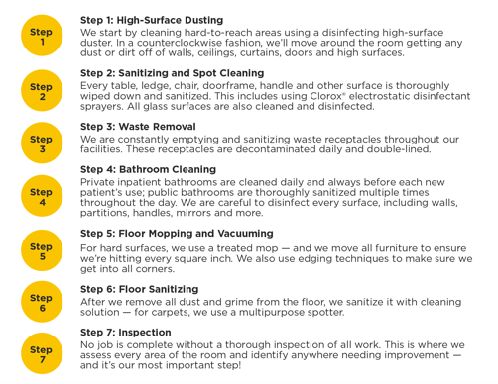
7 Step Cleaning System

Slide 4
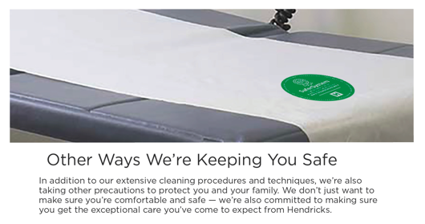
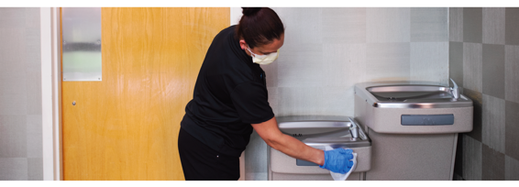
7 Step Cleaning System

